Slide 1
Chemistry – Nov 12, 2010
Get out the atomic history worksheet
For a homework check
P3 Challenge- Atomic Structure Pretest
  Pick up a Pretest and a periodic table. (Don’t write on PT and please return.)
  Work quietly alone for the pretest. Don’t use notes. (Graded on completion)
  Write IDK if you don’t know. Don’t leave blanks.
Objective –
  Atomic quantities and Subatomic particles

Slide 2
Chemistry – Nov 9, 2018
Agenda –
  Percent composition
  Conservation of Mass
  Subatomic particles
  Subatomic particles and the periodic table
  Mass number, Atomic number
  Ions
  Isotopes and natural abundance
  Average atomic mass
Assignment: -
  Atoms, Ions and Mass Worksheet

Slide 3

Summary of Atomic Theory History 1
Scientists | Contribution | Atomic Model
Democritus (400 BC) | Idea of atoms | Logical discrete bits of matter (Discredited due to Aristotle)
Boyle (1661) | The Scientific Method Need to base on experiment | None.
Lavoisier (1789), | Law of Conservation of Mass Discovered Oxygen | None.
Dalton (1805) | Law of Multiple Proportions Atomic Theory | Solid Spheres Atomic model

Slide 4
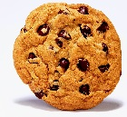

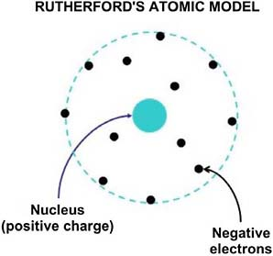
Summary of Atomic Theory History 2
Scientists | Contribution | Atomic Model
Thomson (1897) | Discovers Electron w/ Cathode Ray Tube | Plum Pudding/Choc Chip Pos. dough, neg. chips
Millikan (1909) | Mass & Charge of Electron with Oil-drop Experiment
Rutherford (1909); | Discovers nucleus w/ Gold Foil experiment | Positive massive nucleus, Tiny neg electrons in space Nuclear Model

Slide 5
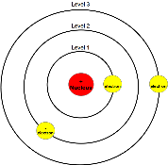
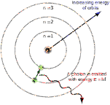
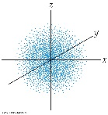
Summary of Atomic Theory History 3
Scientists | Contribution | Atomic Model
Chadwick (1932) | Discovers neutrons | Nuclear model, including neutrons
Bohr (1913) | Explains atomic spectra; Solves physics charge problem | Quantized planetary Bohr model
Schrödinger, Heisenberg, Einstein, de Broglie, Born et al. (1915-1930) | Quantum Mechanics; Wave-particle duality; Uncertainty | Quantized probability electron clouds

Slide 6
Percent Composition
The Law of Definite Proportions says that every sample of a given compound will have the same ratio of elemental components by mass.
A typical elemental analysis of a compound results in a list of the mass of each element.
From this information, you can calculate the percent composition of each element by dividing each by the total mass of the sample.
Recall % = part/whole x 100
Ex: A 25.00 g sample of table salt (which consists of only sodium and chlorine) was found to contain 9.83 g of sodium. A) What mass of chlorine is present in the sample? B) What is the percent composition of sodium and chlorine in table salt?

Slide 7
Conservation of Mass
If you know the total amount of mass present in a system before some action happens, the same mass must be present afterward.
1) Inventory the masses before; 2) Inventory the masses after; 3) Set equal.
Ex: Magnesium burns in oxygen with a bright white light. If a 48.6 g sample of magnesium reacts to form 80.6 g of magnesium oxide, how many grams of oxygen reacted?
Follow up: What is the percent composition of magnesium and oxygen in magnesium oxide?

Slide 8
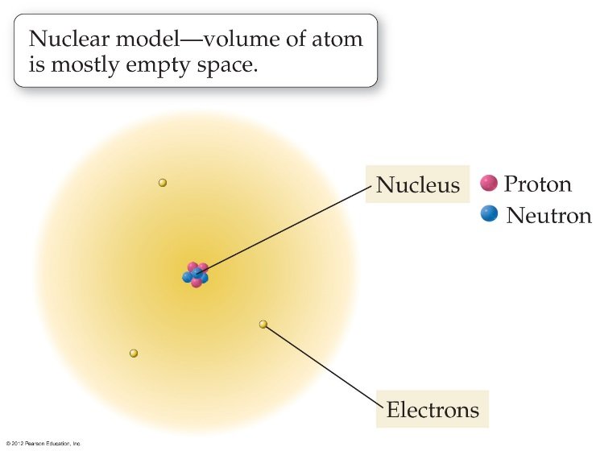
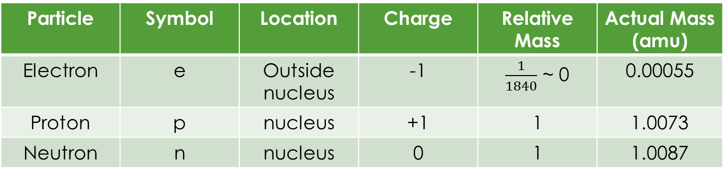
Subatomic Particles
Proton, Electron and Neutron (memorize all but last column)
1 amu ≡ 1/12 the mass of a carbon-12 atom
Particle | Symbol | Location | Charge | Relative Mass | Actual Mass (amu)
Electron | e | Outside nucleus | -1 | $\frac{1}{1840}$ ~ 0 | 0.00055
Proton | p | nucleus | +1 | 1 | 1.0073
Neutron | n | nucleus | 0 | 1 | 1.0087

Slide 9
Atomic number and Mass number
Atomic number is the most fundamental quantity.
  Given the symbol Z
  Equals the number of protons (an integer)
    Identifies the type of atom
  Equal to the number of electrons in a neutral atom
Mass number
  Given the symbol A
  Equals the number of protons + neutrons for an atom (an integer)

Slide 10
Ions
Because electrons are on the outside of atoms, they are the part of atoms that can chemically react and can be changed.
If an atom has the same number of electrons as protons, it is neutral and has no charge.
If an atom has more electrons than protons, it is an anion and has a negative charge for however many more electrons it has.
  Atom has gained electron(s) ….usually less than 4: -, 2-, 3-, 4-
If an atom has less electrons than protons, it is a cation and has a positive charge for however many less electrons it has.
  Atom has lost electron(s) … usually less than 4: +, 2+, 3+, 4+
Charge = #p – #e

Slide 11
Isotopes and Symbols
The number of neutrons can also vary. (The number of protons cannot.)
Each isotope of an element contains a different number of neutrons.
The isotope of an element is labeled using its mass number, A.
Notation: Carbon-12 and Carbon-14, or C-12 and C-14 , or
In general, if X is the atomic symbol, then isotopes are X-A or
Notice that Z and X are always matched, so Z is redundant and is often left off:
#neutrons = A – Z Ex: has 8 neutrons

Slide 12
Fill in Table for atoms and ions
Symbol | Protons, p | Neutrons, n | Electrons, e | Atomic #, Z | Mass #, A | Charge, q
⁵²Cr
⁵²Cr²⁺
 | 25 | 30 |  |  |  | 0
 |  | 64 | 48 |  |  | 2+
 |  |  |  | 15 | 32 | 3-
 | 82 |  |  |  | 207 | 0

Slide 13
Atomic Mass
Given the symbol m
Average mass of the atom in amu (decimal value)
  Weighted average
Each isotope has its own atomic mass
For any sample of an element, the particular isotopes present will reflect to natural abundance of each type of isotope found on earth.
http://www.chem.ualberta.ca/~massspec/atomic_mass_abund.pdf
Ex: Ne-20 90.48% Ne-21 0.27% Ne-22 9.25%
Each isotope has its own mass: 19.992440, 20.993847, 21.991386

Slide 14
Average Atomic Mass
Atomic Mass on periodic table is a weighted average.
To calculate atomic mass
Let M_{n}= the mass of isotope n (amu)
Let ab_{n}= the relative abundance of isotope n (percent as a decimal)

Slide 15
Exit Slip - Homework
Exit Slip:
  An element has a mass number of 66 and contains 36 neutrons.
  What is the element?
  How many protons does it have?
  How many electrons does it have?
What’s Due? (Pending assignments to complete.)
  Atoms, Ions and mass Worksheet
What’s Next? (How to prepare for the next day)
  Read Holt p84 - 88

